Slide 1




MERN Stack - Advanced
Lecture 1-2 (ES6 + React Basics)
Instructor: Mr. Ahsan Shehzad

Slide 2









MERN – The Big Picture
Requests
Responses
Server
Business Logic, File Storage, …
Client (Browser)
Data
e.g. JSON Format
Database Queries
Presentation/ UI
Database Server
Persistent Data Storage
Credentials would be exposed in client-side code: Huge security issue!

Slide 3
Last Week Review
What is the Web?
History of WEB 1.0 to 3.0
Overview of Full-stack web development
Overview of the course
Development Environment Setup for MERN

Slide 4
Outline
ES6
React Basics
Hands-on practice

Slide 5
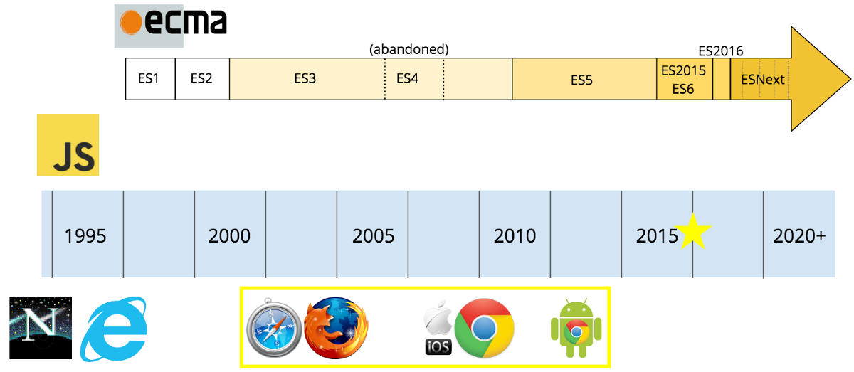
What is ES6?
ES6 stands for ECMAScript 6.
ECMAScript was created to standardize JavaScript, and ES6 is the 6th version of ECMAScript, it was published in 2015, and is also known as ECMAScript 2015.

Slide 6
Why Should I Learn ES6?
React uses ES6, and you should be familiar with some of the new features like:
Classes
Arrow Functions
Variables (let, const, var)
Array Methods like .map()
Destructuring
Modules
Ternary Operator
Spread Operator

Slide 7
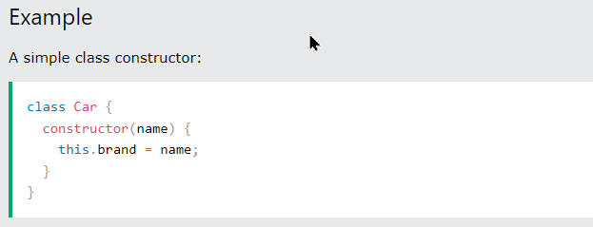
Classes
A class is a type of function, but instead of using the keyword function to initiate it, we use the keyword class, and the properties are assigned inside a constructor() method.
Notice the case of the class name. We have begun the name, "Car", with an uppercase character. This is a standard naming convention for classes.

Slide 8
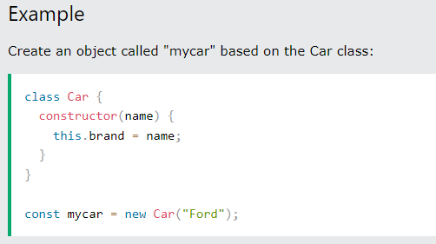
Classes

Slide 9
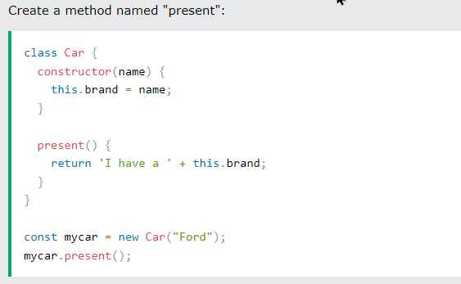
Method in Classes

Slide 10
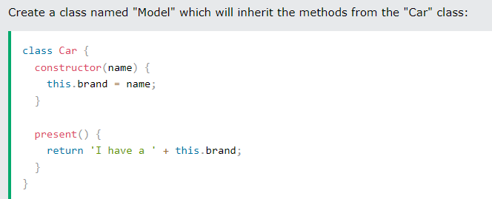
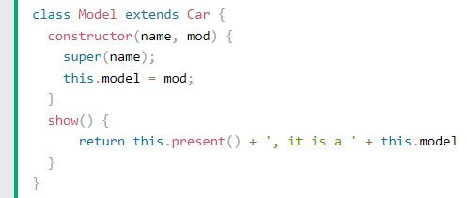

Class Inheritance

Slide 11
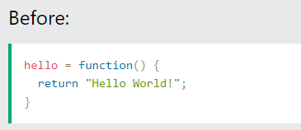
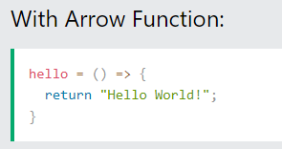
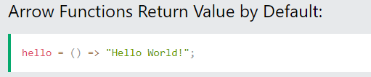
Arrow Functions
Arrow functions allow us to write shorter function syntax:

Slide 12
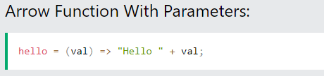
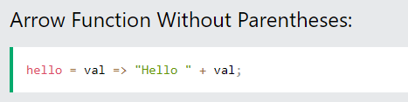
Arrow Functions

Slide 13
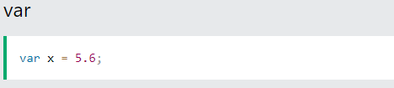

Variables
Now, with ES6, there are three ways of defining your variables: var, let, and const.
If you use var outside of a function, it belongs to the global scope.
If you use var inside of a function, it belongs to that function.
If you use var inside of a block, i.e. a for loop, the variable is still available outside of that block.

Slide 14
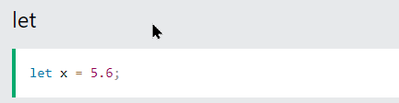

Variables
let is the block-scoped version of var and is limited to the block (or expression) where it is defined.
If you use let inside of a block, i.e. a for loop, the variable is only available inside of that loop.

Slide 15
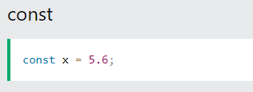
Variables
const is a variable that once it has been created, its value can never change.

Slide 16
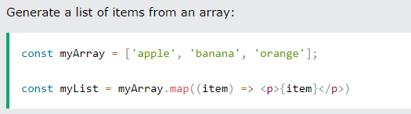
Array Methods
There are many JavaScript array methods.
One of the most useful in React is the .map() array method.
The .map() method allows you to run a function on each item in the array, returning a new array as the result.

Slide 17
Destructuring
Sandwich from Refrigerator example
Destructuring makes it easy to extract only what is needed.

Slide 18
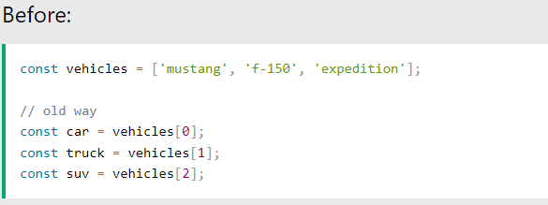
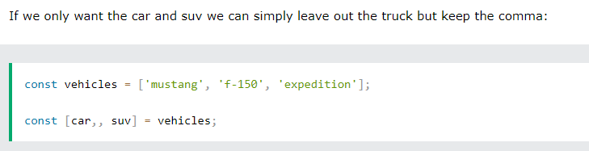
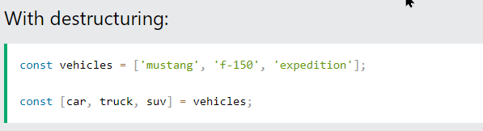
Destructing Arrays

Slide 19
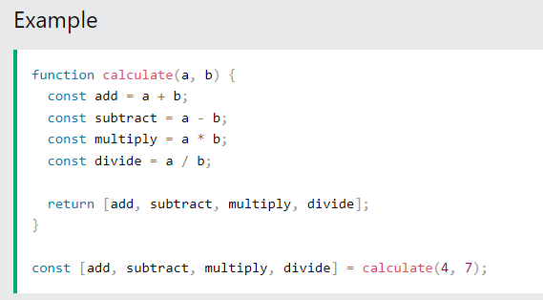
Destructing Arrays

Slide 20
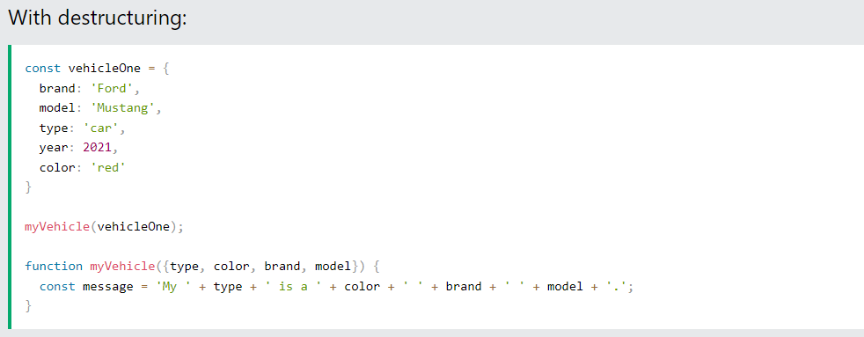
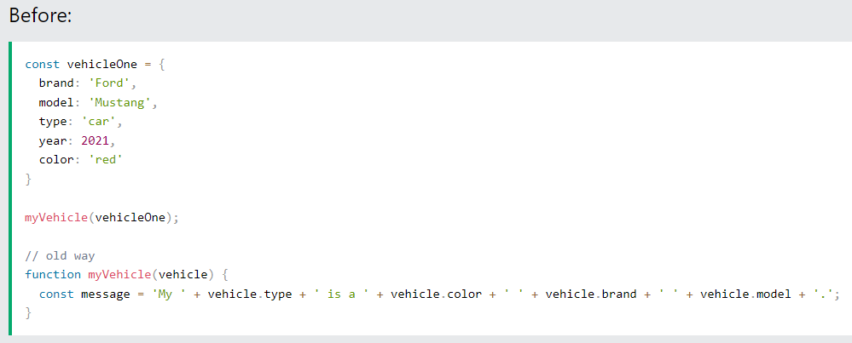
Destructuring Objects

Slide 21
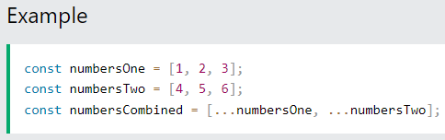
Spread Operator
The JavaScript spread operator (...) allows us to quickly copy all or part of an existing array or object into another array or object.
[1,2,3,4,5,6]

Slide 22
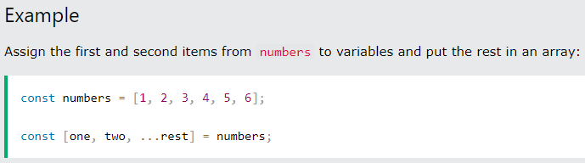
Spread Operator
The spread operator is often used in combination with destructuring.
1
2
3,4,5,6

Slide 23
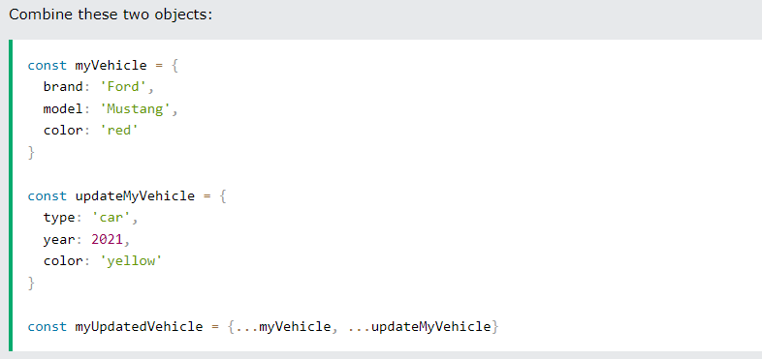
Spread Operator
We can use the spread operator with objects too:
Notice the properties that did not match were combined, but the property that did match, color, was overwritten by the last object that was passed, updateMyVehicle. The resulting color is now yellow.
{
"brand": "Ford",
"model": "Mustang",
"color": "yellow",
"type": "car",
"year": 2021
}

Slide 24
Modules
JavaScript modules allow you to break up your code into separate files.
This makes it easier to maintain the code-base.
ES Modules rely on the import and export statements.
Export
You can export a function or variable from any file.
There are two types of exports: Named and Default.

Slide 25
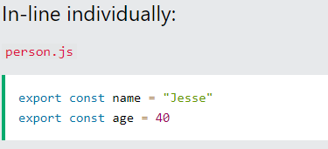
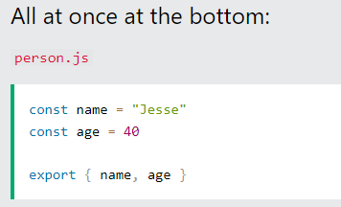
Modules
Named Exports
You can create named exports two ways. In-line individually, or all at once at the bottom.

Slide 26
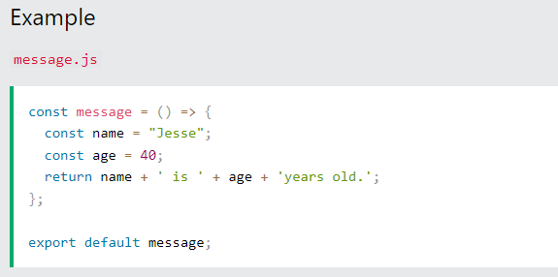
Modules
Default Exports
You can only have one default export in a file.

Slide 27
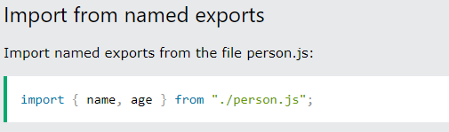
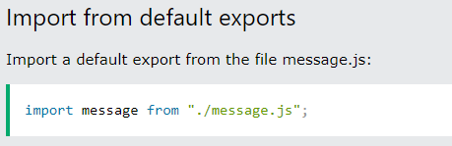
Modules
Import
You can import modules into a file in two ways, based on if they are named exports or default exports.
Named exports must be destructured using curly braces. Default exports do not.

Slide 28
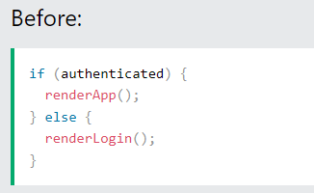
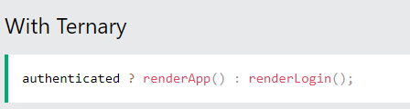
Ternary Operator
The ternary operator is a simplified conditional operator like if / else.
Syntax: condition ? <expression if true> : <expression if false>

Slide 29
React Basics

Slide 30
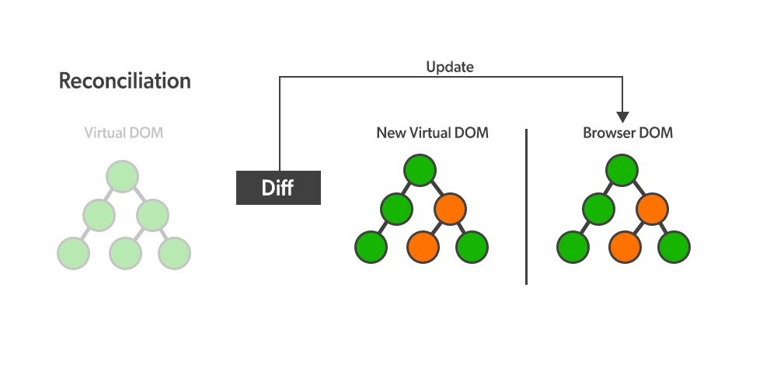
React Introduction
What is React?
Static vs Dynamic HTML
React, sometimes referred to as a frontend JavaScript framework, is a JavaScript library created by Facebook.
React is a tool for building UI components.
How does React Work?
React creates a VIRTUAL DOM in memory.
React only changes what needs to be changed!
React.JS History
Current version of React.JS is V18.0.0 (April 2022).
Initial Release to the Public (V0.3.0) was in July 2013.

Slide 31
React Getting Started
01-React Directly in HTML
02-Setting up a React Environment
If you have npx and Node.js installed, you can create a React application by using create-react-app.
npx create-react-app my-react-app
Run the React Application
Run this command to run the React application my-react-app:
npm start
React uses ES6

Slide 32
Summary
ES6
Classes
Arrow Functions
Variables (let, const, var)
Array Methods like .map()
Destructuring
Modules
Ternary Operator
Spread Operator
React Basics

